Slide 1
SPARK BASICS
2. Programming with Spark

Slide 2
Learning Outcomes
Upon completion of this lesson, students will be able to:
Understand how to work with RDDs
Creation
Basic transformations and actions
key/value pairs
Understand how to work with pair RDDs
Creation
Basic transformations and actions
Understand PageRank algorithm in Scala on Spark

Slide 3
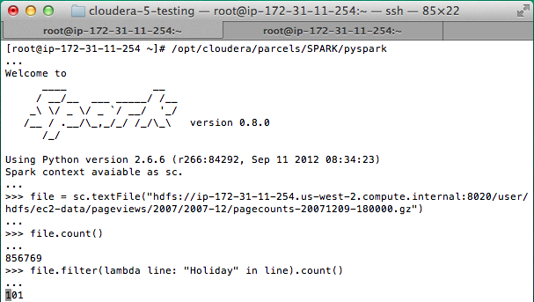
Using the Shell
Launching:
spark-shell
pyspark (IPYTHON=1)
Modes:
MASTER=local ./spark-shell # local, 1 thread MASTER=local[2] ./spark-shell # local, 2 threads MASTER=spark://host:port ./spark-shell # cluster
Main entry point to Spark functionality
Available in shell as variable sc

Slide 4
Creating RDDs
# Turn a Python collection into an RDD
sc.parallelize([1, 2, 3])
# Load text file from local FS, HDFS, or S3
sc.textFile(“file.txt”)
sc.textFile(“directory/*.txt”)
sc.textFile(“hdfs://namenode:9000/path/file”)
# Use existing Hadoop InputFormat (Java/Scala only)
sc.hadoopFile(keyClass, valClass, inputFmt, conf)

Slide 5
Basic Transformations/Actions: Scala
scala>val number = List(1, 2, 3)
number: List[Int] = List(1, 2, 3)
scala> squares = number.map(x=>x*x)
scala> val squares = number.map(x=>x*x)
squares: List[Int] = List(1, 4, 9)
scala> val even = squares.filter(x=>x%2==0)
even: List[Int] = List(4)
scala>val range = even.flatMap(x => Range (1,x,1))
range: List[Int] = List(1, 2, 3)
scala> val range = even.flatMap(x => Range (1,x,2))
range: List[Int] = List(1, 3)
scala> val rangeRDD = sc.parallelize(range)
scala> val counter = rangeRDD.collect()
Array[Int] = Array(1, 3)

Slide 6
Basic Transformations
nums = sc.parallelize([1, 2, 3])
# Pass each element through a function
squares = nums.map(lambda x: x*x) // {1, 4, 9}
# Keep elements passing a predicate
even = squares.filter(lambda x: x % 2 == 0) // {4}
# Map each element to zero or more others
nums.flatMap(lambda x: => range(x))
# => {0, 0, 1, 0, 1, 2}
Range object (sequence of numbers 0, 1, …, x-1)

Slide 7
Basic Actions
nums = sc.parallelize([1, 2, 3])
# Retrieve RDD contents as a local collection
nums.collect() # => [1, 2, 3]
# Return first K elements
nums.take(2) # => [1, 2]
# Count number of elements
nums.count() # => 3
# Merge elements with an associative function
nums.reduce(lambda x, y: x + y) # => 6
# Write elements to a text file
nums.saveAsTextFile(“hdfs://file.txt”)

Slide 8
Working with Key-Value Pairs
Spark’s “distributed reduce” transformations operate on RDDs of key-value pairs
Python: pair = (‘a’, ‘b’) pair[0] # => a pair[1] # => b
Scala: val pair = (‘a’, ‘b’) pair._1 // => a pair._2 // => b
Java: Tuple2 pair = new Tuple2(‘a’,’b’); pair._1 // => a pair._2 // => b

Slide 9
Some Key-Value Operations
pets = sc.parallelize( [(“cat”, 1), (“dog”, 1), (“cat”, 2)])
pets.reduceByKey(lambda x, y: x + y) # => {(cat, 3), (dog, 1)}
pets.groupByKey() # => {(cat, [1, 2]), (dog, [1])}
pets.sortByKey() # => {(cat, 1), (cat, 2), (dog, 1)}
reduceByKey also automatically implements combiners on the map side

Slide 10
Example: Word Count
Python
Scala
lines = sc.textFile(“hamlet.txt”)
counts = lines.flatMap(lambda line: line.split(“ ”)).map(lambda word => (word, 1)).reduceByKey(lambda x, y: x + y)
lines = sc.textFile(“hamlet.txt”)
counts = lines.flatMap(line => line.split(“ ”) ).map(word => (word, 1)).reduceByKey(_+_)
“to” “be” “or”
(to, 1) (be, 1) (or, 1)
(be, 2) (not, 1)
“to be or”
“not” “to” “be”
(not, 1) (to, 1) (be, 1)
“not to be”
(or, 1)
(to, 2)

Slide 11
Other Key-Value Operations
visits = sc.parallelize([ (“index.html”, “1.2.3.4”), (“about.html”, “3.4.5.6”), (“index.html”, “1.3.3.1”) ])
pageNames = sc.parallelize([ (“index.html”, “Home”), (“about.html”, “About”) ])
visits.join(pageNames) # (“index.html”, (“1.2.3.4”, “Home”)) # (“index.html”, (“1.3.3.1”, “Home”)) # (“about.html”, (“3.4.5.6”, “About”))
visits.cogroup(pageNames) # (“index.html”, ([“1.2.3.4”, “1.3.3.1”], [“Home”])) # (“about.html”, ([“3.4.5.6”], [“About”]))

Slide 12
Setting the Level of Parallelism
All the pair RDD operations take an optional second parameter for number of tasks
words.reduceByKey(lambda x, y: x + y, 5)
words.groupByKey(5)
visits.join(pageViews, 5)

Slide 13
Creating pair RDDs in Spark
Some return pair RDDs for their key/value data
Otherwise, regular RDD can be turned into a pair RDD by running a map()
Example:
We consider code that starts with an RDD of lines of text and the first word in each line as keys
We will see the code in Python and Scala

Slide 14
Creating pair RDD: Python
Creating a pair RDD using the first word as the key in Python:
In Python, for the functions on keyed data to work we need to return an RDD composed of tuples

Slide 15
Creating pair RDD: Scala
Creating a pair RDD using the first word as the key in Scala
In Scala, tuples should be returned for the keyed data to be available
An implicit conversion on RDDs of tuples exists to provide the additional key/value functions.

Slide 16
Transformations on Pair RDDs
Pair RDDs contain tuples, we need to pass functions that operate on tuples rather than on individual elements
Pair RDDs are allowed to use all the transformations available to standard RDDs
Example: {(1, 2), (3, 4), (3, 6)}

Slide 17
Transformations on Pair RDDs : Example
Function name | Purpose | Example | Result
reduceByKey(func) | Combine values with the same key. | rdd.reduceByKey((x, y) => x + y) | {(1, 2), (3, 10)}
groupByKey() | Group values with the same key. | rdd.groupByKey() | {(1, [2]), (3, [4, 6])}
combineByKey(createCombiner,mergeValue, mergeCombiners,partitioner) | Combine values with the same key using a different result type.
mapValues(func) | Apply a function to each value of a pair RDD without changing the key. | rdd.mapValues(x => x+1) | {(1, 3), (3, 5), (3, 7)}

Slide 18
Transformations on Pair RDDs : Example
Function name | Purpose | Example | Result
flatMapValues(func) | Apply a function that returns an iterator to each value of a pair RDD, and for each element returned, produce a key/value entry with the old key. Often used for tokenization. | rdd.flatMapValues(x => (x to 5) | {(1, 2), (1, 3), (1, 4), (1, 5), (3, 4), (3, 5)}
keys() | Return an RDD of just the keys. | rdd.keys() | {1, 3, 3}
values() | Return an RDD of just the values. | rdd.values() | {2, 4, 6}
sortByKey() | Return an RDD sorted by the key. | rdd.sortByKey() | {(1, 2), (3, 4), (3, 6)}

Slide 19
More on Pair RDDs
Pair RDDs support all the functions supported by simple RDDs
Example:
For the previously used RDD, filter out lines larger than 20 characters
Simple filter on second element in Python
Simple filter on second element in Scala

Slide 20
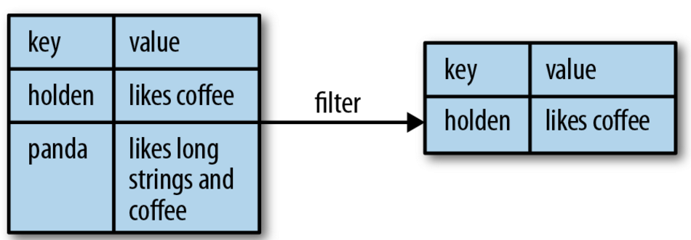
More on Pair RDDs
Pictorial representation of the operation
What if one wants to access the value part of the <Key Value> pair if pair RDDs?
Spark provides mapValues(func) function for that
This function is same as : map{case (x, y): (x, func(y))}

Slide 21
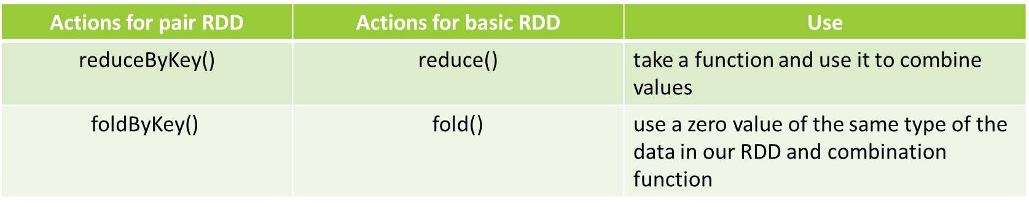
More on Pair RDDs : Aggregations
Spark has operations for pair RDDs to combine values with the same key, same to those for simple RDDs

Slide 22
reduceByKey() and mapValues()
Code sample for reduceByKey() and mapValues()
rdd.mapValues(lambda x: (x, 1)).reduceByKey(lambda x, y: (x[0] + y[0], x[1] + y[1]))
Per-key average with reduceByKey() and mapValues() in Python
rdd.mapValues(x => (x, 1)).reduceByKey((x, y) => (x._1 + y._1, x._2 + y._2))
Per-key average with reduceByKey() and mapValues() in Scala

Slide 23
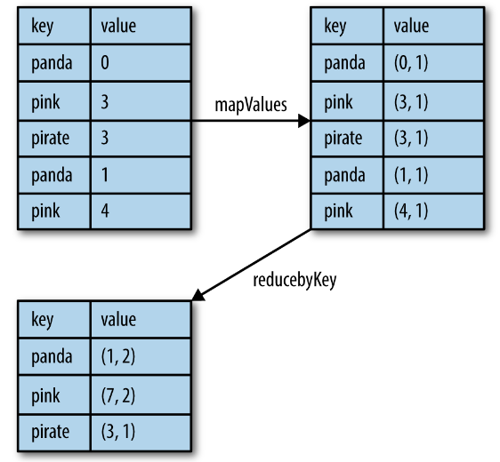
reduceByKey() and mapValues()
Pictorial representation of Per-key average data flow

Slide 24
Actions on Pair RDDs
Function | Description | Example | Result
countByKey() | Count the number of elements for each key | rdd.countByKey() | {(1, 1), (3, 2)}
collectAsMap() | Collect the result as a map to provide easy lookup | rdd.collectAsMap() | Map{(1, 2), (3, 4), (3, 6)}
lookup(key) | Return all values associated with the provided key | rdd.lookup(3) | [4, 6]

Slide 25
PageRank algorithm in Scala on Spark
The PageRank algorithm outputs a probability distribution used to represent the likelihood that a person randomly clicking on links will arrive at any particular page.
Initialize each page’s rank to 1.0.
On each iteration, have page p send a contribution of rank(p)/numNeighbors(p) to its neighbors (the pages it has links to).
Set each page’s rank to 0.15 + 0.85 * contributionsReceived.
The last two steps repeat for several iterations, during which the algorithm will con‐ verge to the correct PageRank value for each page. In practice, it’s typical to run about 10 iterations.

Slide 26
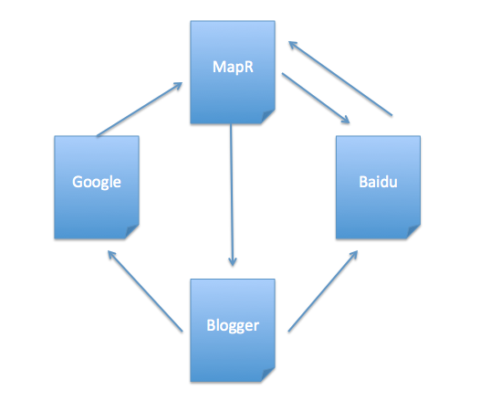
PageRank: Sample Data
Above diagram shows there are 4 web pages with theirs outbound & inbound links.

Slide 27
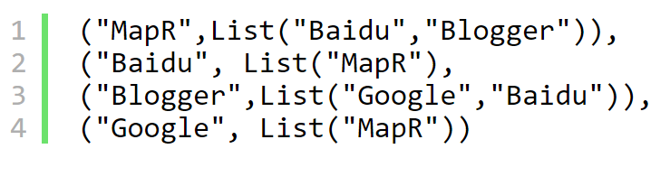
PageRank: Sample Data
If we consider the outbound links as a data type (String, List(String)), then data should be:

Slide 28
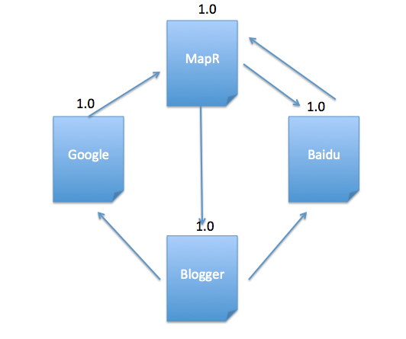
PageRank: Solution (Step 1)
Initialize each page’s rank to 1.0
1. val links = sc.parallelize(List(("MapR",List("Baidu","Blogger")),
("Baidu", List("MapR")),("Blogger",List("Google","Baidu")),
("Google", List("MapR")))).partitionBy(new HashPartitioner(4)).persist()
2. var ranks = links.mapValues(v => 1.0)

Slide 29
val contributions = links.join(ranks) .flatMap { case (url, (links, rank)) => links.map(dest => (dest, rank / links.size)) }
PageRank: Solution (Step 2)
On each iteration, have page p send a contribution of rank(p)/numNeighbors(p) to its neighbors (the pages it has links to).

Slide 30
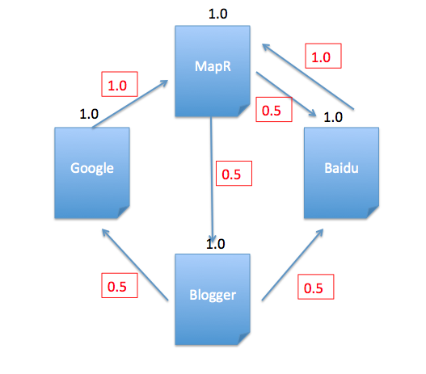
PageRank: Solution (Step 2)
See contributions in red, and it matches the calculations using scala:
1. scala> contributions.collect
2.res26: Array[(String, Double)] = Array((MapR,1.0), (Baidu,0.5), (Blogger,0.5), (Google,0.5), (Baidu,0.5), (MapR,1.0))

Slide 31
PageRank: Solution (Step 3)
Set each page’s rank to 0.15 + 0.85 * contributionsReceived
val ranks = contributions.reduceByKey((x, y) => x + y)
.mapValues(v => 0.15 +0.85*v)

Slide 32
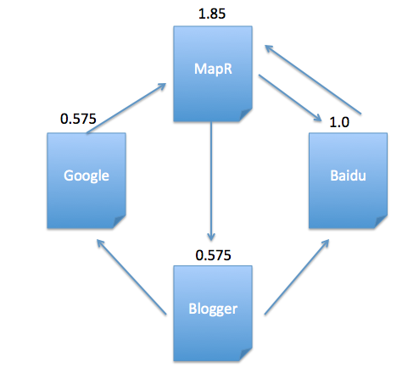
PageRank: Solution
After 1st iteration, current pagerank value for each page is:
1. scala> ranks.collect
2. res27: Array[(String, Double)] = Array((Google,0.575), (MapR,1.8499999999999999), (Blogger,0.575), (Baidu,1.0))
Then the last two steps repeat for several iterations.

Slide 33
Sources
https://www.safaribooksonline.com/library/view/learning-spark/9781449359034/ch04.html
http://www.openkb.info/2016/03/understanding-pagerank-algorithm-in.html

